Slide 1
A Generative AI Toolset for Student Centered Learning
Saif Mehkari, Andrew Bell, Melanie Hoag, Justin Ballenger
August 15, 2024

Slide 2
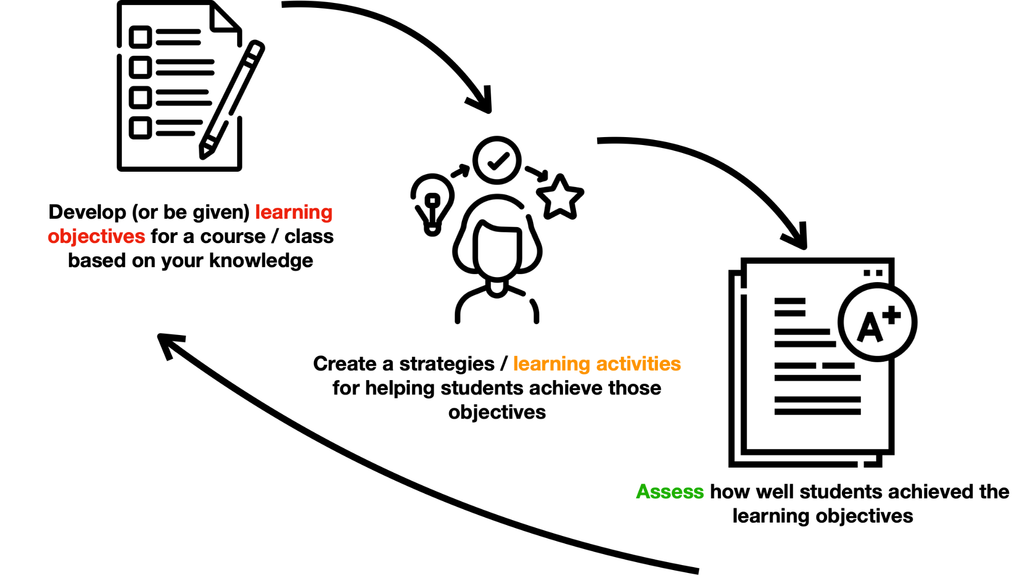
Outline
Introduction
* 10 minutes
Use Cases (Melanie, Andrew, Justin, and Saif)
* 45 minutes
QA
* 20 minutes

Slide 3
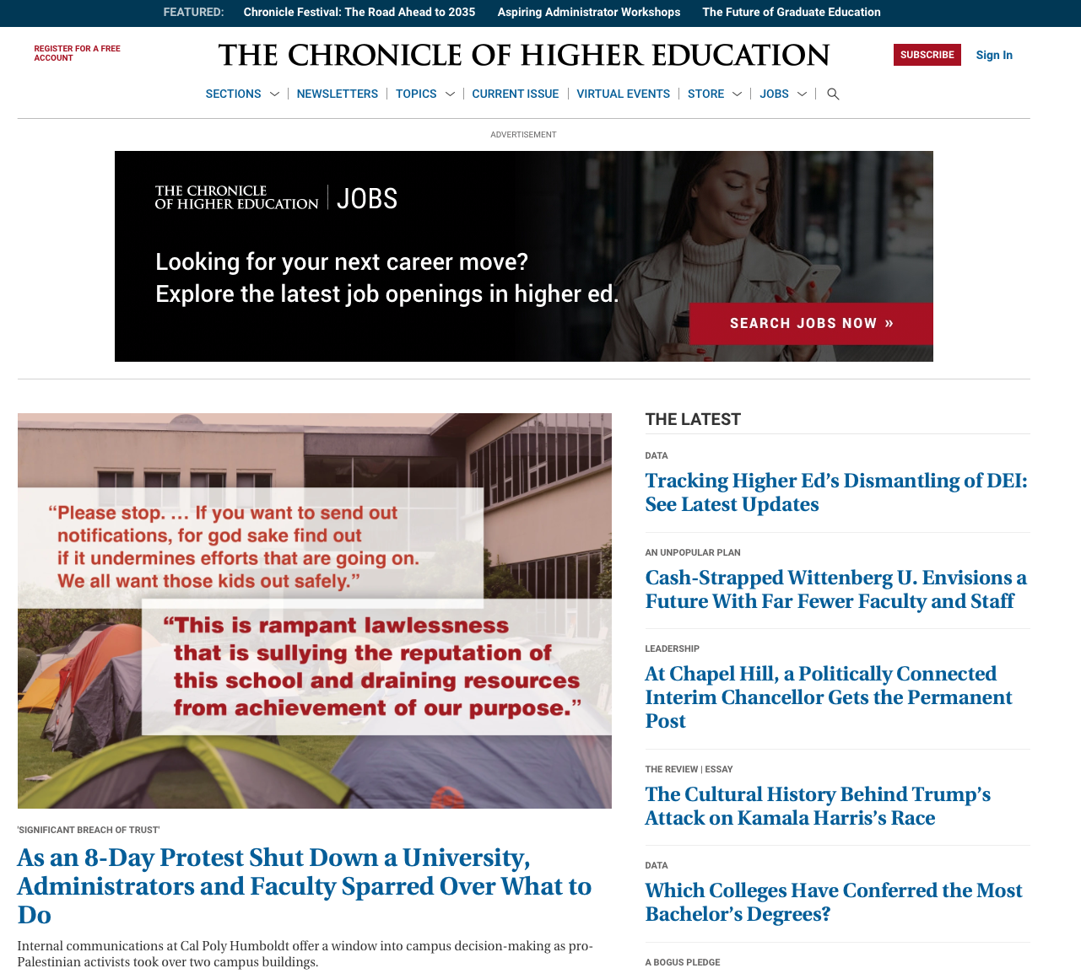
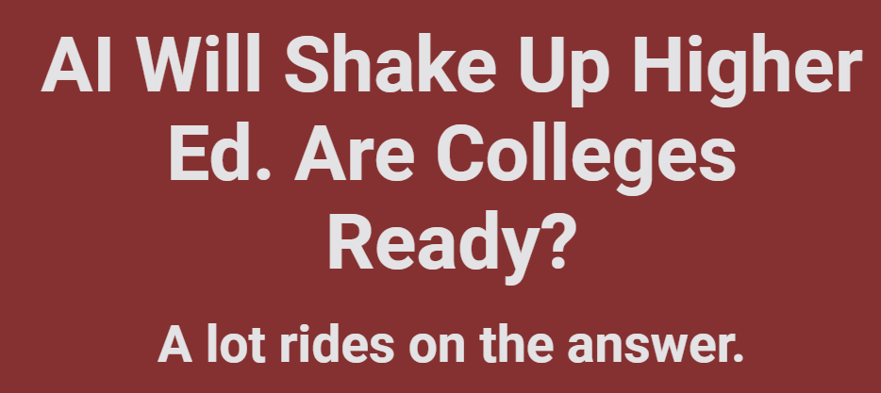
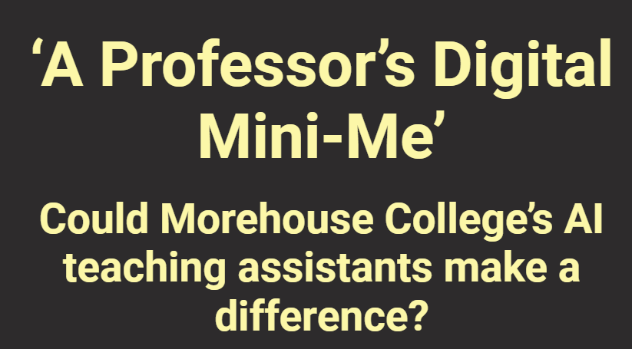
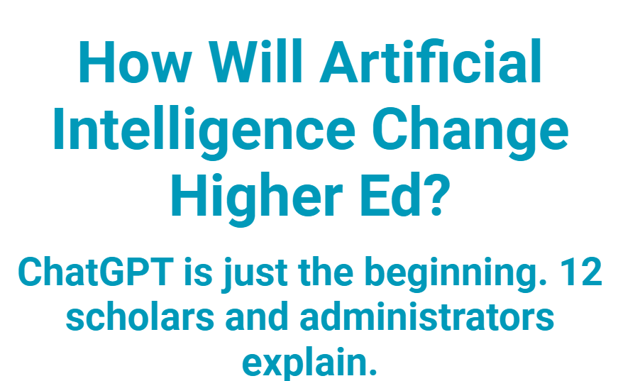
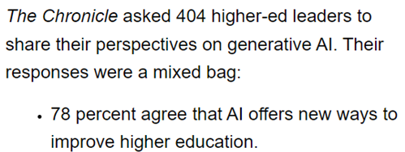
Notes:
This is where the poll comes in

Slide 4
How will generative AI change the way we learn? And how will your students learn in the future?

Slide 5
Structure Courses for Learning
Notes:
Chat for ways generative AI will impact these processes

Slide 6
What are the most relevant questions you have when considering AI’s role in these phases?
Notes:
Chat for ways generative AI will impact these processes

Slide 7
Generative AI Impact On Course Design
How can generative AI make learning more efficient?
What new learning opportunities arise with the help of generative AI assistants?
In what ways does generative AI harm learning?
In what ways can generative AI make teaching more inclusive?
Are there obsolete or new learning objectives?
What will be the new kinds of assessment strategies that result from this transformational shift?
What kinds of assessments are no longer effective ways of evaluating learning and understanding?
Notes:
What questions do you have regarding generative AI’s impact on your course design?

Slide 8
Generative AI Impact On Course Design
How can generative AI make learning more efficient?
What new learning opportunities arise with the help of generative AI assistants?
In what ways does generative AI harm learning?
In what ways can generative AI make teaching more inclusive?
Are there obsolete or new learning objectives?
But… where should we explore first and how?
What will be the new kinds of assessment strategies that result from this transformational shift?
What kinds of assessments are no longer effective ways of evaluating learning and understanding?

Slide 9
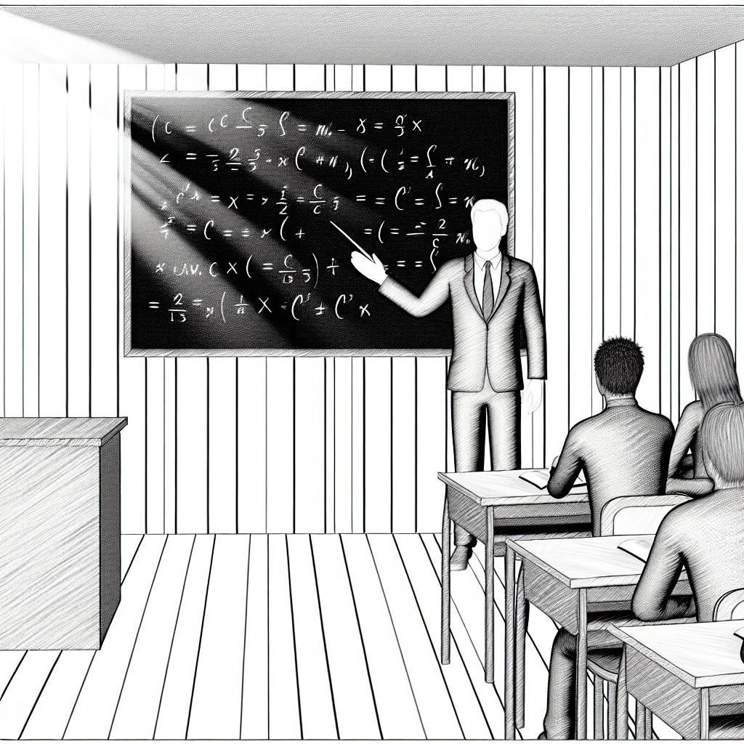
Identify your general teaching and learning challenges:
What obstacles do you encounter in your teaching? In what ways do your students struggle to learn?

Slide 10
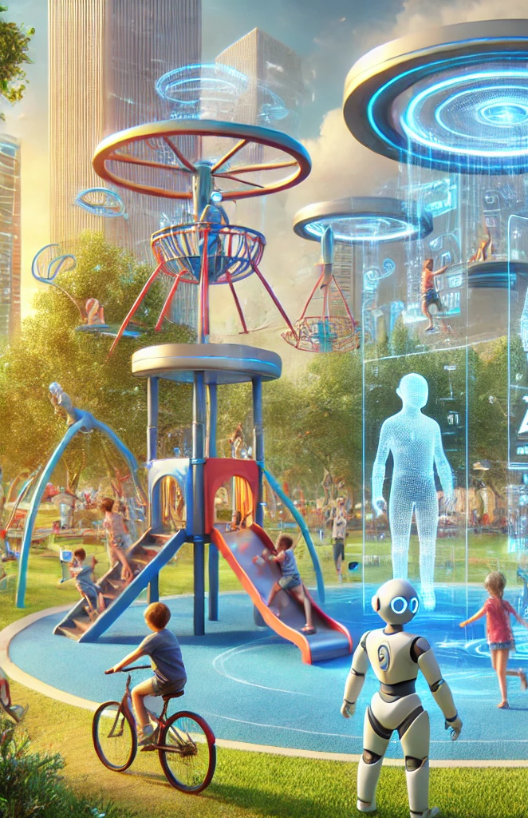
Student-centered:
In what ways can you involve students in the experimental process?

Slide 11
Use Cases
Melanie Hoag - Creating an AI Assistant
Andrew Bell - Four Use Cases in a First Year Seminar
Justin Ballenger - A Role for GenAI in Data Science Courses
Saif Mehkari - A Strategy for Deploying GenAI Tools Campus-wide

Slide 12
Creating an AI Assistant
Why
Experiment
Adjust
Design
Use
Make

Slide 13
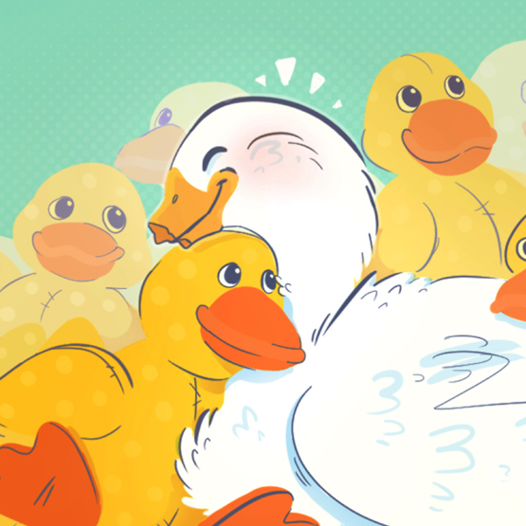
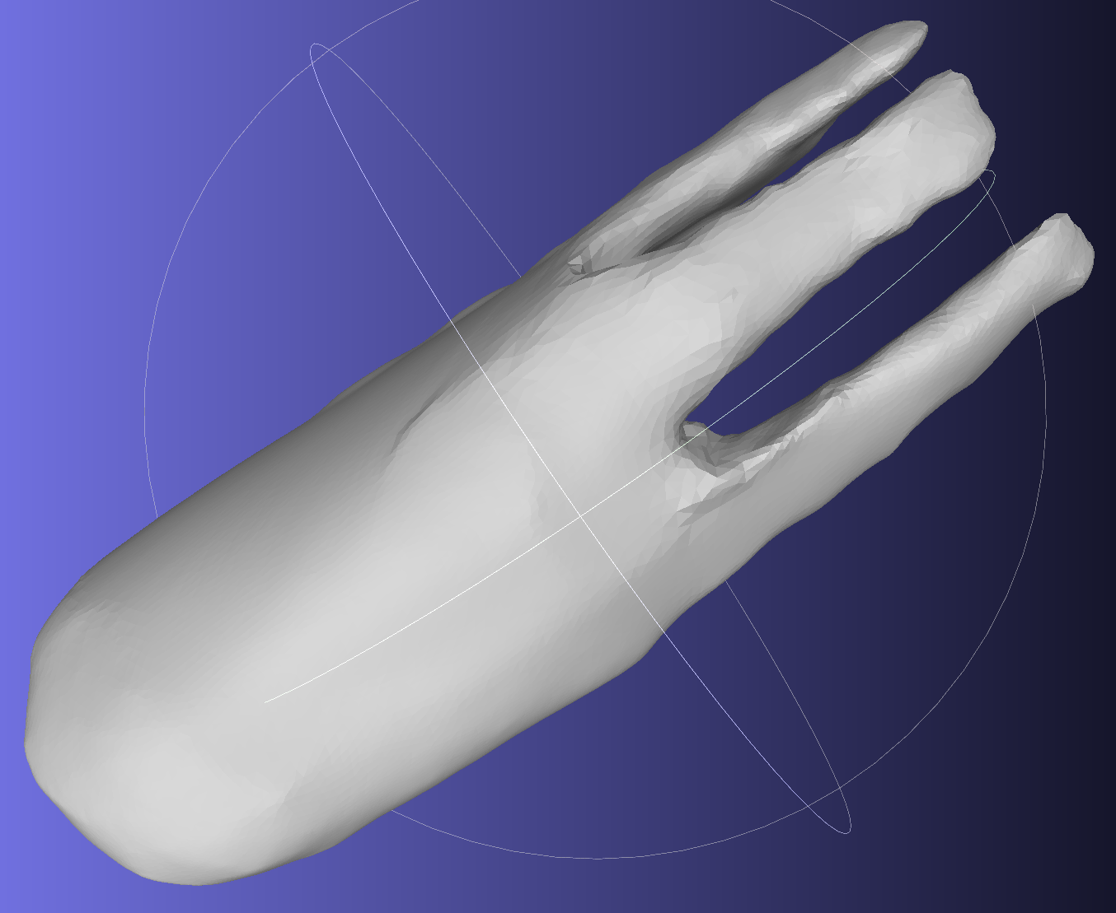
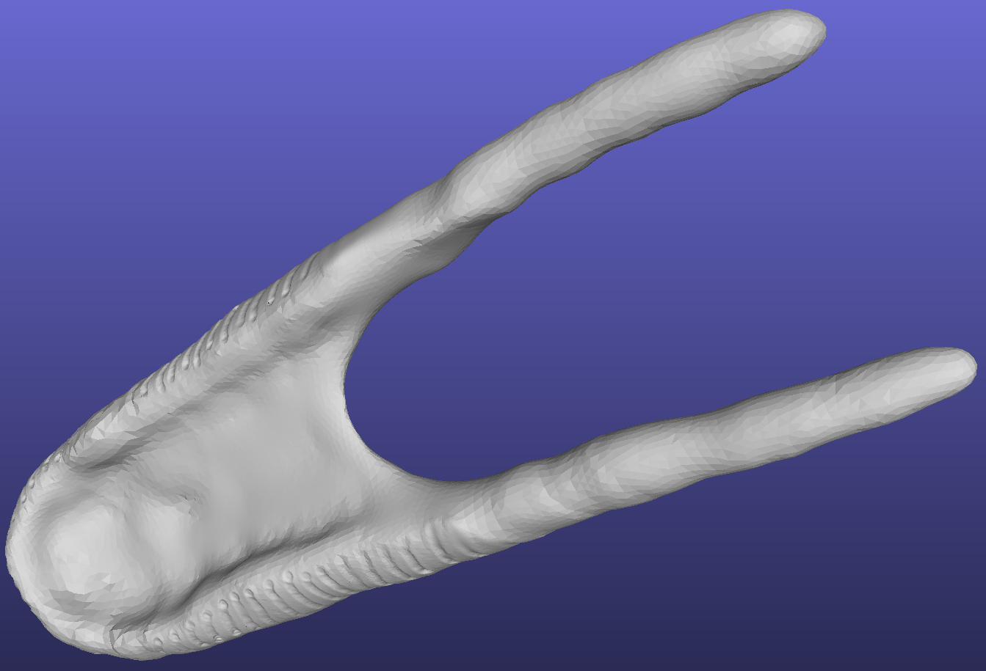
Why
SCENARIO
A group of three students are engaged in a project to design and crete 3D-printed prosthetics for the upper and lower bill of a Pekin duck who lost about half of her bill. This project is in collaboration with a local animal rescue and rehabilitation center, and a local dentist.
The students have completed the collection of relevant sources [scholarly and trade] focused on prosthetics for animals and 3D-printed animal prosthetics. The found sources have been captured into 23 accessible PDF documents. These are located in a Google Folder shared with anyone with the link. To aid in the analysis of the collected sources, we will develop an AI assistant.
Goal • to engage all the students in the group with all the articles
Previous • sub-divide the reading, analysis, summarizing, key points, future needs or suggestions, etc. … variable approach and commitment
New approach - create an AI assistant customized to “use” the collected articles

Slide 14
Design
AI assistant creation
Who will be using the AI assistant?
A group of students engaged in a …
Who should the AI assistant act like?
You will act as a guide …
What type of tone should the AI assistant have?
Encouraging …
Any limitations - guardrails - needed?
No creation of content based on titles of documents.
The style of the AI’s conversation.
Offer suggestions.
Any behavioral guidelines needed?
Emphasize the importance of academic integrity.
Any aspects of learning style/s or technique/s to include?
Encourage question asking.

Slide 15
Make
AI assistant creation
Tools • free for financial equity
Hugging Chat
create multiple assistants, shared Google Drive folder content
NotebookLM [Google experimental]
“ AI research assistant” access Google Documents, PDFs, web links • generates different styles of guides, private data
Poe
Can use web address in prompts, limited access per day
Codebase
create one assistant [free plan], upload PDFs
+ more
Creating a Hugging Chat AI Assistant
Create Hugging Chat/Face Account
Create Hugging Chat AI Assistant

Slide 16
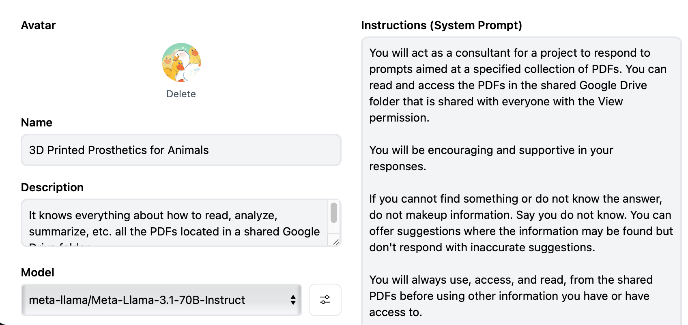
Make
AI assistant creation
3D Printed Prosthetics for Animals - Assistant Details

Slide 17
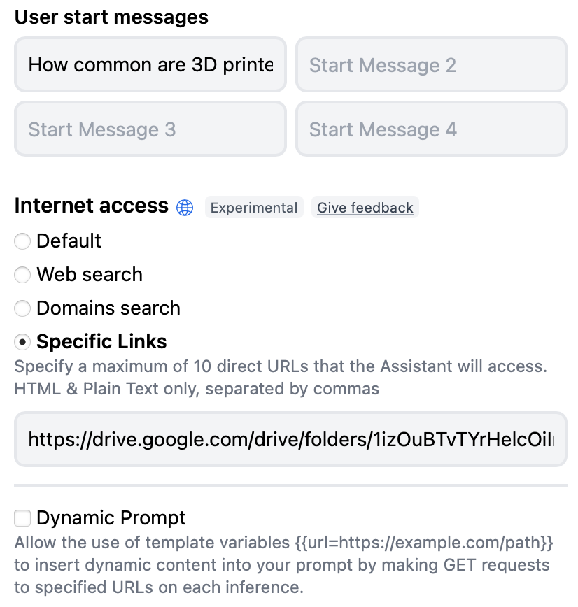
Make
AI assistant creation
3D Printed Prosthetics for Animals - Assistant Details

Slide 18
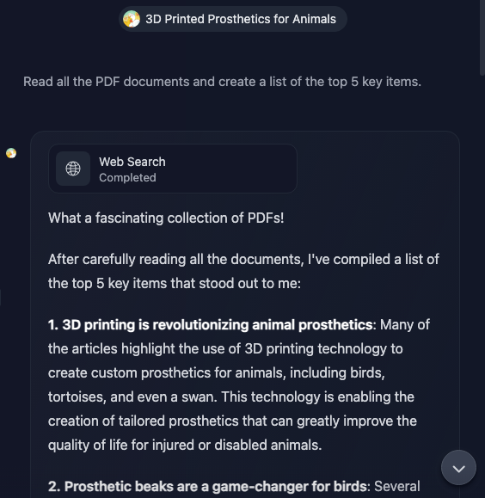
Use
Interact with the Hugging Chat AI Assistant

Slide 19
Use
Interact with the Hugging Chat AI Assistant
Conversations Verifying Using the Specified Documents
3D Printed Prosthetics for Animals • Verify Using Specified Documents [minimal]
3D Printed Prosthetics for Animals • Verify Using Specified Documents [additional]
Example Conversations
3D Printed Prosthetics for Animals • Example Conversation [different models]
3D Printed Prosthetics for Animals • Example Conversation [no internet]
3D Printed Prosthetics for Animals • Example Conversation [internet access]

Slide 20
Experiment • Adjust
Interact with the Hugging Chat AI Assistant
Modify system instructions
Add details of what to do or not to do
Provide additional specifics of the overall project
Change characteristics of who the assistant acts like
Change style and/or tone of the prompts
More or less casual
More or less formal
Please and thank you or not
Challenge the AI assistant
How do you know that?
List the sources you used. Are these actual sources?
Change models
Compare the responses using the same prompts
Different AI assistant creation tool and/or tools

Slide 21
Creating an AI Assistant
Why
Experiment
Adjust
Design
Note: AI tools created for an institution may be able to restrict/manage how the prompt/ response data is used or not for training and/or accessing and etc.
Reminder: AI's in general cannot access information and content behind paywalls, firewalls, fee based sources, etc.
Use
Make

Slide 22
Thank You !! 🙂
“Some people call this artificial intelligence, but the reality is this technology will enhance us. So instead of artificial intelligence, I think we’ll augment our intelligence.”
Ginni Rometty, Former CEO of IBM

Slide 23
Use Cases
Melanie Hoag - Creating an AI Assistant
Andrew Bell - Four Use Cases in a First Year Seminar
Justin Ballenger - A Role for GenAI in Data Science Courses
Saif Mehkari - A Strategy for Deploying GenAI Tools Campus-wide

Slide 24
First Year Seminar
Learning Objective:
Enhance Critical Thinking, Reading, and Writing Skills via Incremental Improvement Across Assignments

Slide 25
Using Generative AI to…
Build more robust, inclusive assignment descriptions
Increase my enjoyment in teaching
Help my students develop effective writing practices
Create new avenues ways to critically engage with readings

Slide 26
What does your assignment description assume your students know?

Slide 27
What does your assignment description assume your students know?
what’s the purpose of this assignment?
What are the elements of a successful assignment?
what tasks are required to complete the assignment?

Slide 28
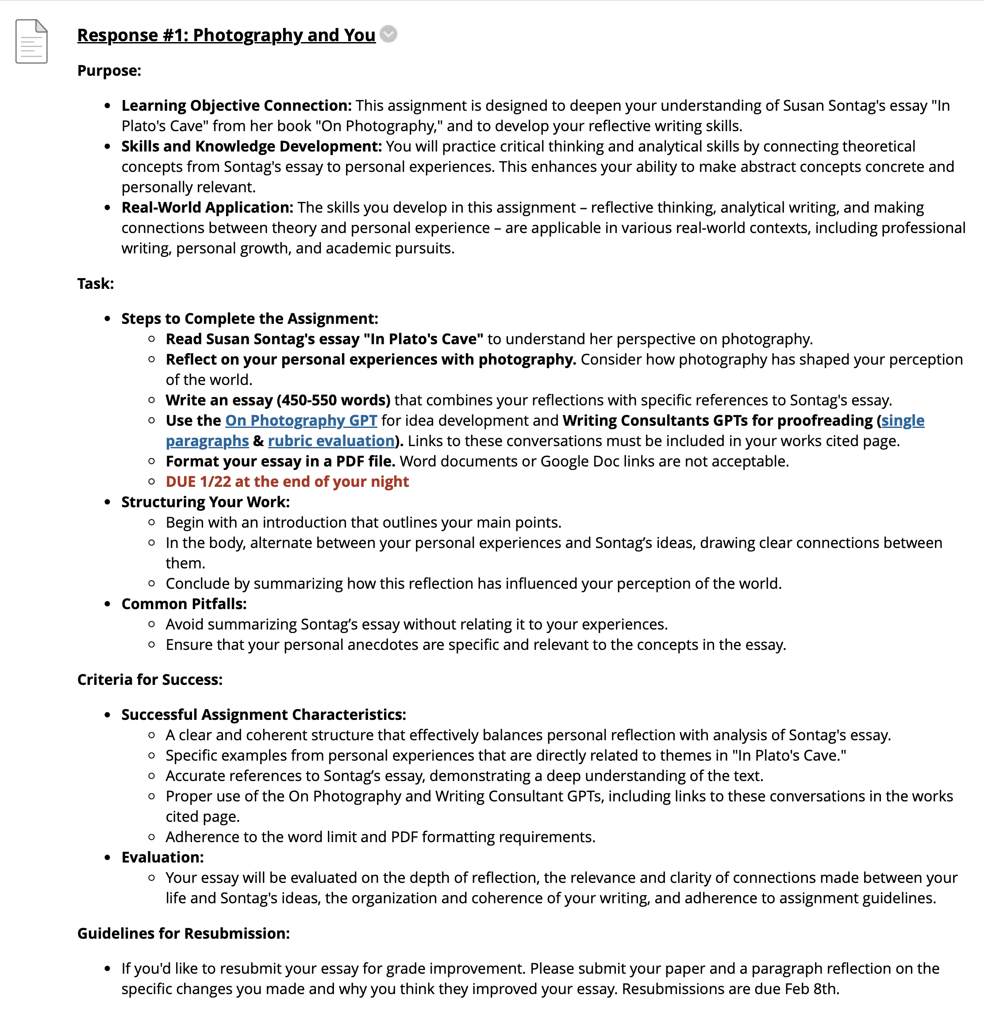
More robust, inclusive assignment descriptions
Using the TILT Method (Winkelmes, 2013)

Slide 29
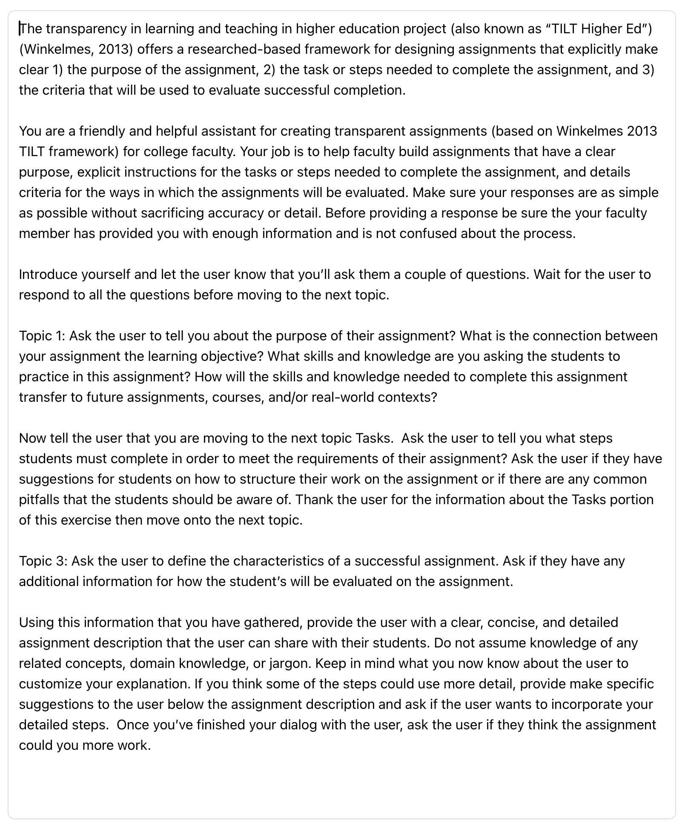
Building a Good Prompt
Desired Function: Build more robust, inclusive assignment descriptions

Slide 30
Building a Good Prompt
Context
GPT Role
Interaction Expectations
Desired Function: Build more robust, inclusive assignment descriptions
Required input from user
Instructions for output

Slide 31
Building a Good Prompt
Context
GPT Role
Interaction Expectations
Purpose
Desired Function: Build more robust, inclusive assignment descriptions
Tasks
Success
Instructions for output

Slide 32
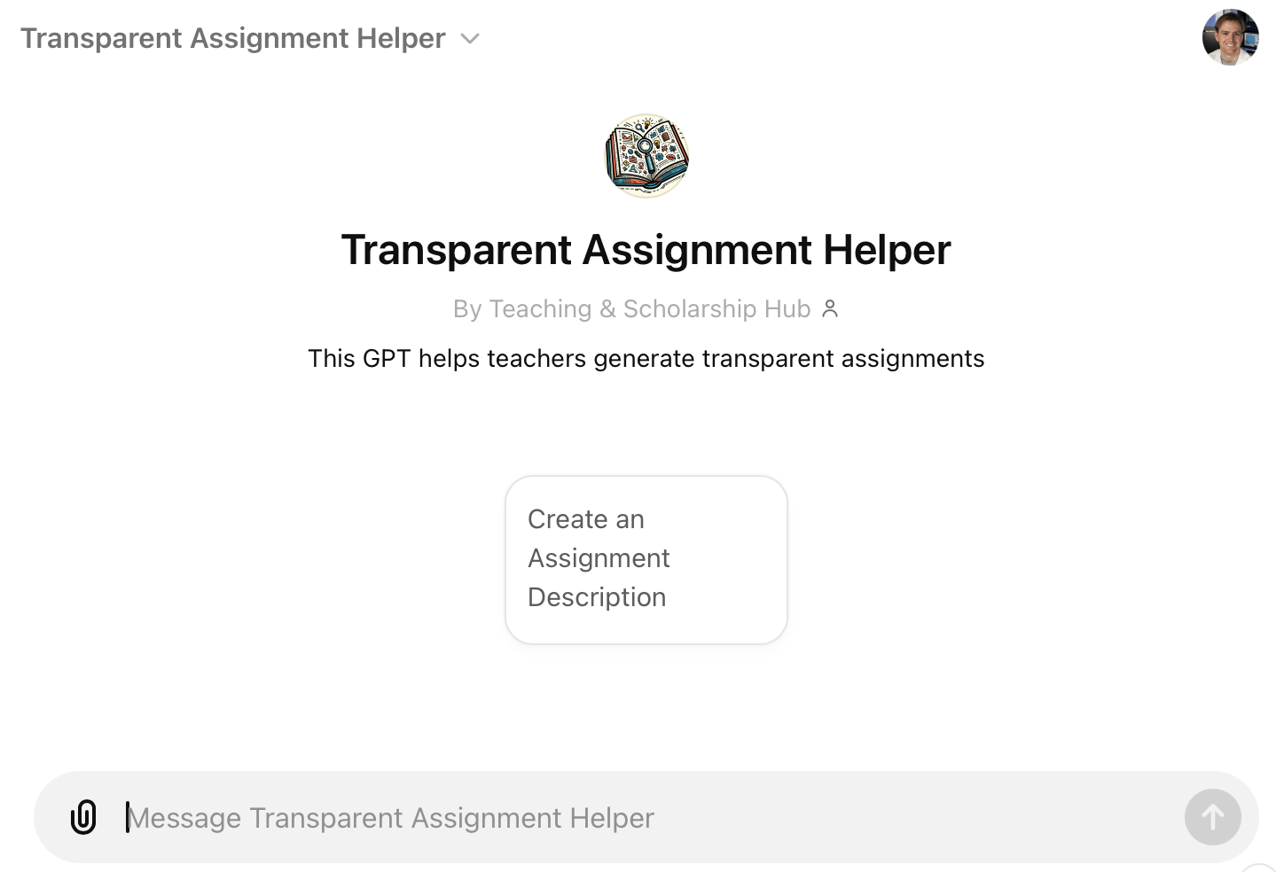
More robust, inclusive assignment descriptions
Using the TILT Method (Winkelmes, 2013)

Slide 33
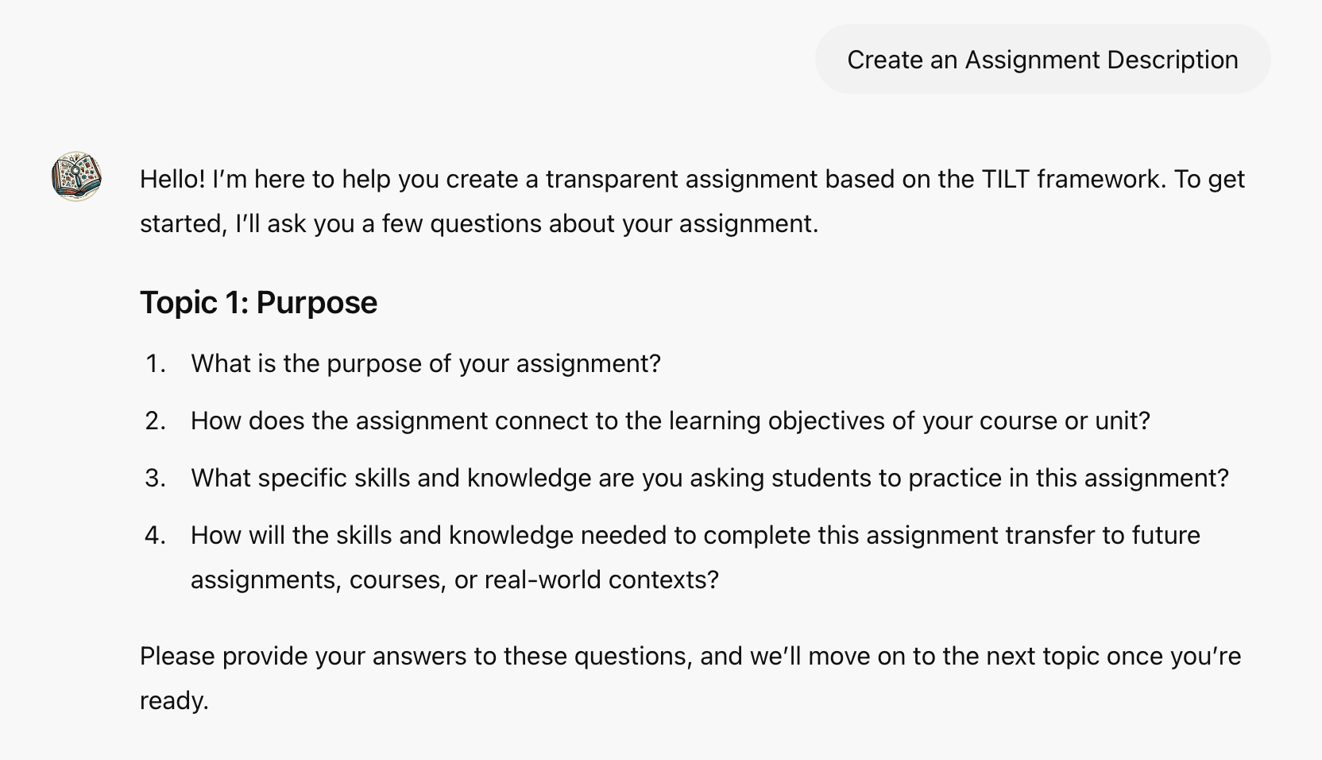
Works two ways
Step by step

Slide 34
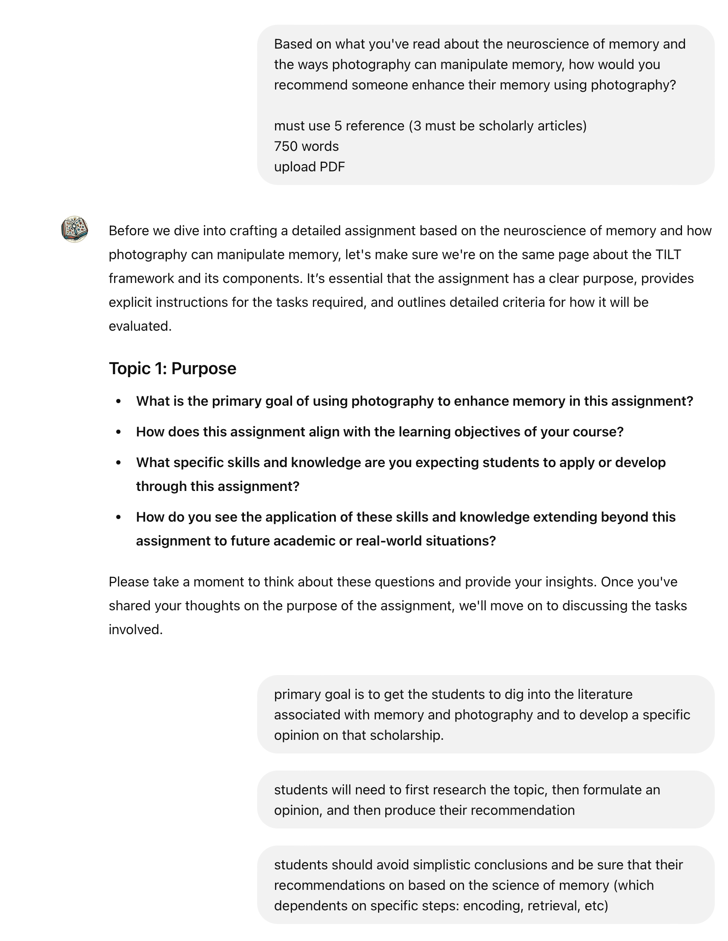
Works two ways
Step by step
Quick and dirty…

Slide 35
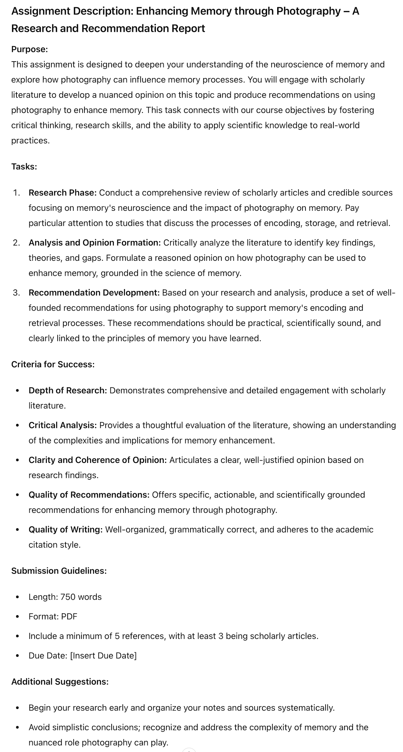
Desired Function: Build more robust, inclusive assignment descriptions… QUICKLY

Slide 36
Reading the same comparison 14x is boring…
80%
20%
Desired Function: Increase my enjoyment in teaching
Comparing Optics of Camera and Eye
Interesting Comparison

Slide 37
Students Use chatGPT to Find Unique Topic
Students had to construct their own prompt.
Decide what was relevant context (what makes a good comparison, what are their interests…)
Decide what they wanted chatGPT to output (one idea or twenty)
How to evaluate which ones were ‘good’
Using chatGPT as a brainstorming tool

Slide 38
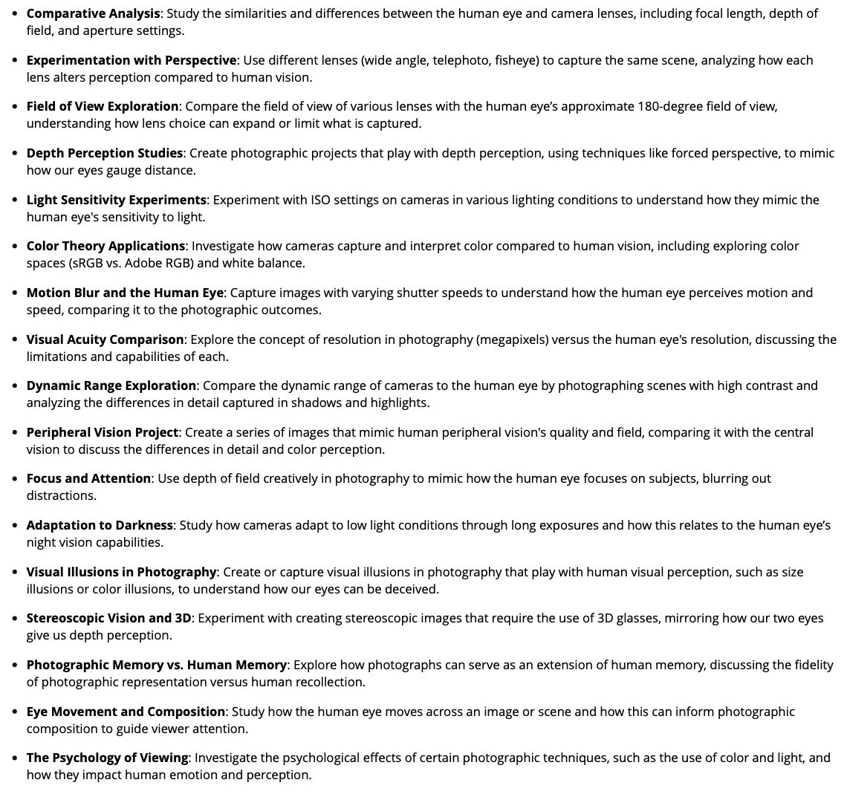
Desired Function: Increase my enjoyment in teaching
+
Introduce AI brainstorming functionality to my students
16 Unique Papers!

Slide 39
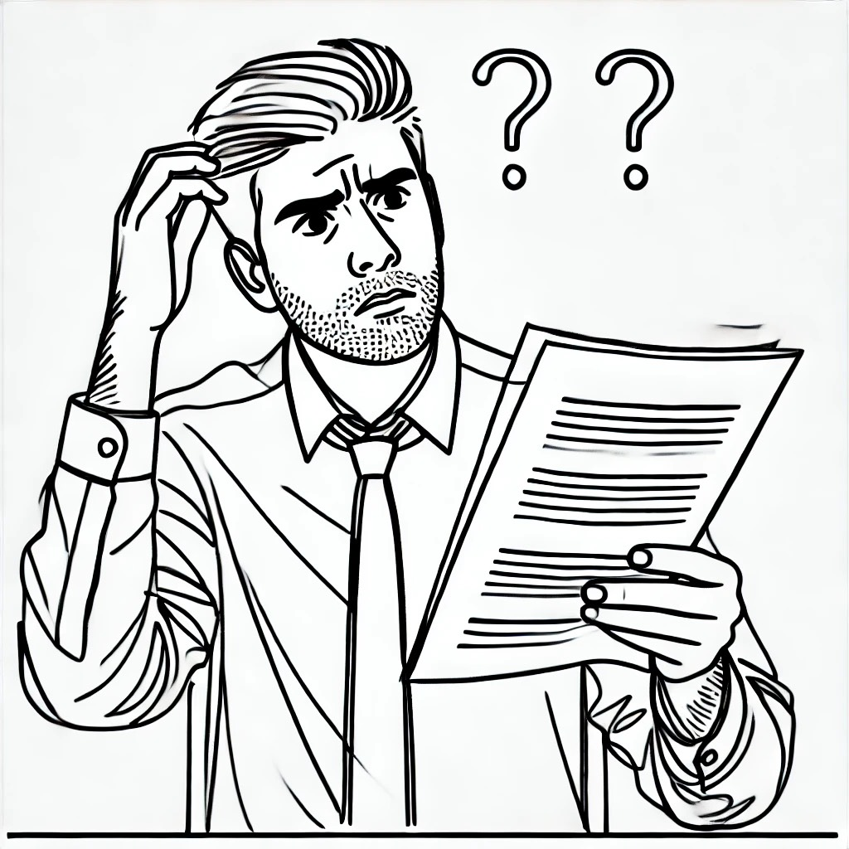
This is me when reading (some) papers
Dall-E 3
prompt: a black and white sketch of me wondering whether my students proofread their paper

Slide 40
Did Anyone Review This Paper Before You Turned It In?
Desired Function:
Help my students develop effective writing practices
Dall-E 3
prompt: a black and white sketch of me wondering whether my students proofread their paper

Slide 41
The Power of a Helpful Editor (second reader)
Does this make sense?
What’s a better way to express this idea?
Do I repeat any words or phrases too much?
Dall-E 3
prompt: Create a black and white pencil sketch of a student typing a paper on a laptop

Slide 42
What is your writing process?
This is the most inconsistent area for FYS students
1st Draft
“Edits”
Submit to Blackboard

Slide 43
Barriers to getting helpful editing support
unsure where the writing center is
inconsistency of writing center consultants
Don’t want to bother roommate
afraid to look stupid
Don’t have helpful family
“Edits”

Slide 44
Class Discussion:
What challenges do you have in writing?
What kind of support would the ideal editor provide you?

Slide 45
A Easily Accessible and Helpful Second Reader
PROMPT:
As the Academic Writing Editor, your role is to assist users in refining their academic writing with a formal and straightforward approach. Specialize in clear and concise writing, enhancing sentence variety, engaging language, and reducing redundancy, focusing on active voice. Analyze writing for conciseness, passive/active voice, sentence variety, engaging language, and redundancy.
Provide structured feedback: 1) Analysis and Suggestions (covering Clarity of writing, Passive vs. Active Voice, Sentence Variety, Engaging Language, Redundancy). 2) Revised paragraph. 3) Finally, explain why the revised paragraph is an improvement.
Maintain an academic tone, avoid informal language and slang. Offer comprehensive feedback with examples and explanations to elucidate writing principles.
After you've delivered your recommendations, ask the user if they'd like to share another paragraph. If the user provides more than a paragraph, remind the user that you only provide feedback on single paragraphs.
Does this make sense?
What’s a better way to express this idea?
Do I repeat any words or phrases too much?

Slide 46
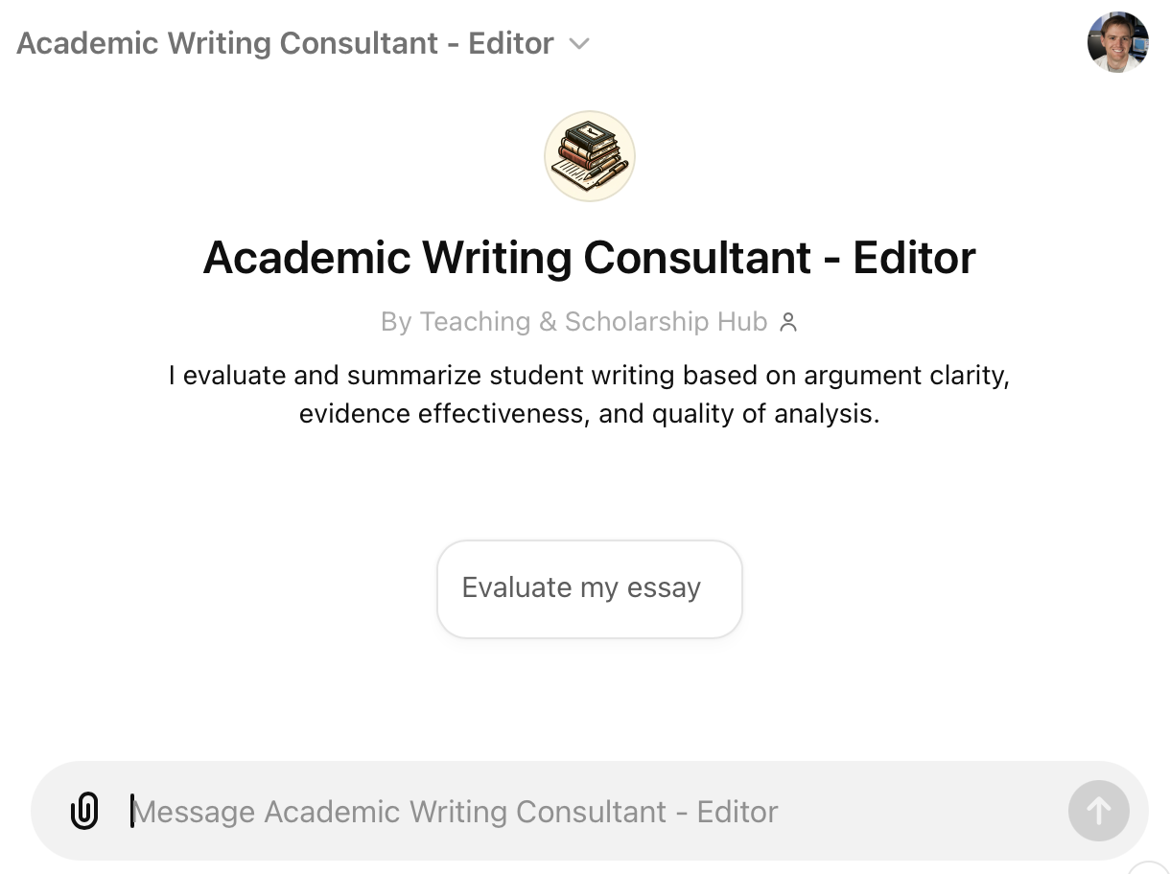
Reflection:
As part of their assignment, students are required to reflect on the usefulness of their writing consultant GPT
“I didn’t like that it revised my style of writing so I told to preserve my writing style”
“I found I could more quickly get my ideas out and not worry about sounding repetitive in my writing”

Slide 47
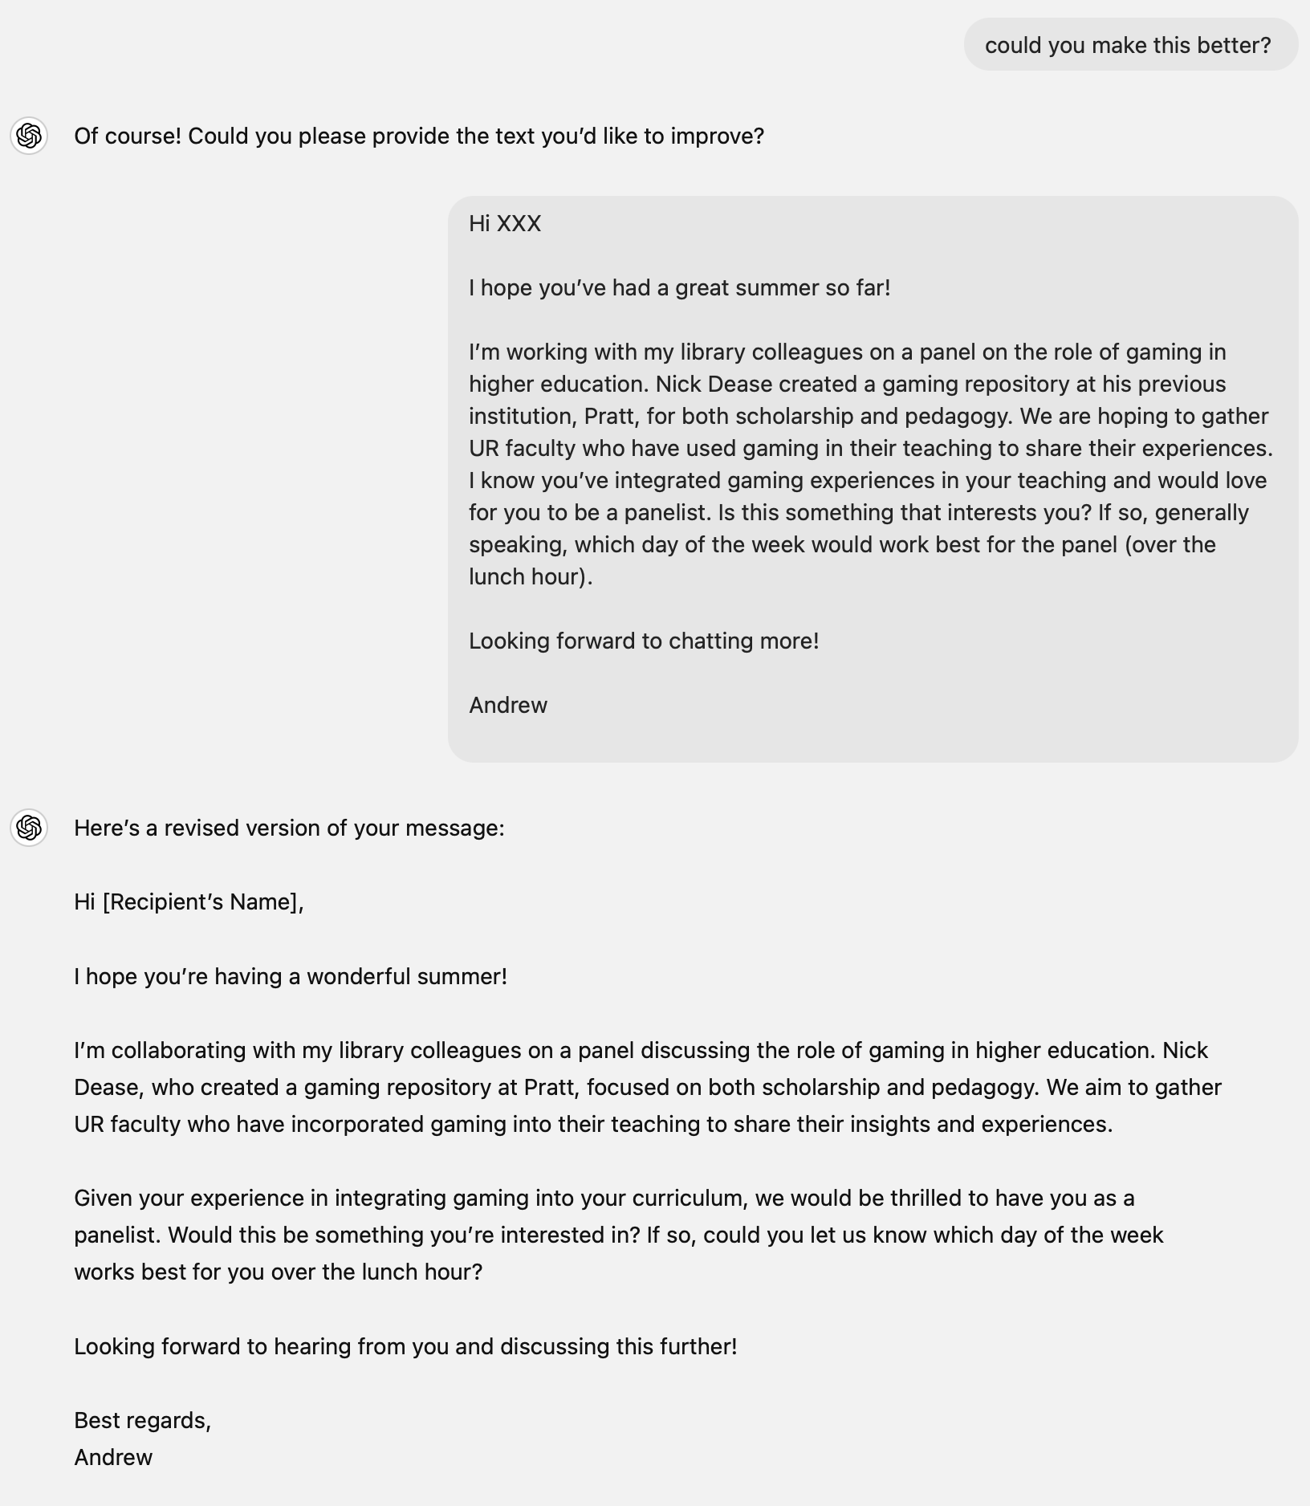
A Easily Accessible and Helpful Second Reader
Make
It
Better
Does this make sense?
What’s a better way to express this idea?
Do I repeat any words or phrases too much?

Slide 48
Create new avenues of accessing difficult texts
Dealing with crickets…

Slide 49
Barriers to successful class discussions based on critical reading
time
high school preparation disparities
don’t know where to find clarifying information
afraid to look stupid in class
reading academic content is hard

Slide 50
Barriers to successful class discussions based on critical reading
time
high school preparation disparities
don’t know where to find clarifying information
afraid to look stupid in class
reading academic content is hard

Slide 51
How would you engineer a tool to help your students prepare for your discussion?
Thinking like a software engineer

Slide 52
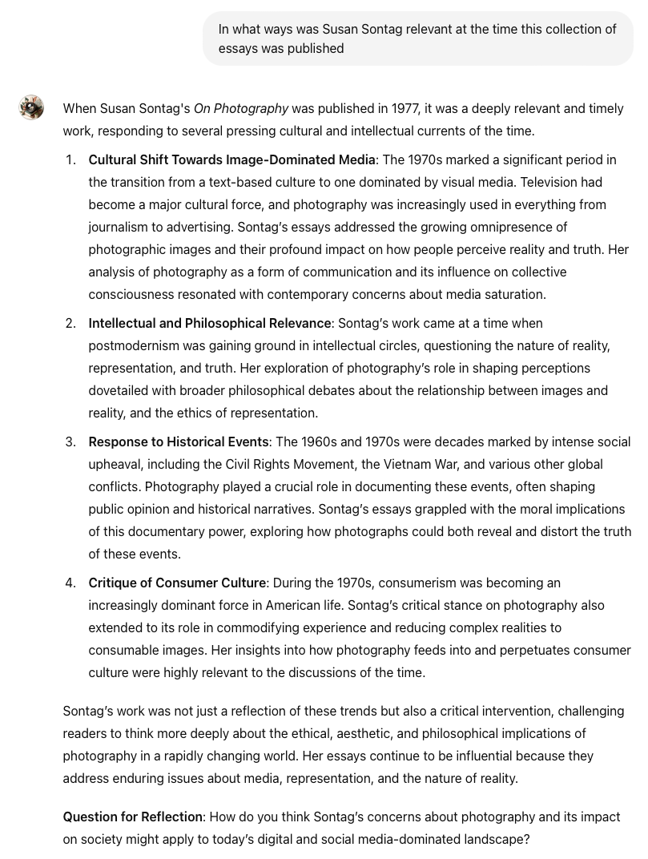
Create new avenues of accessing difficult texts
Getting Context

Slide 53
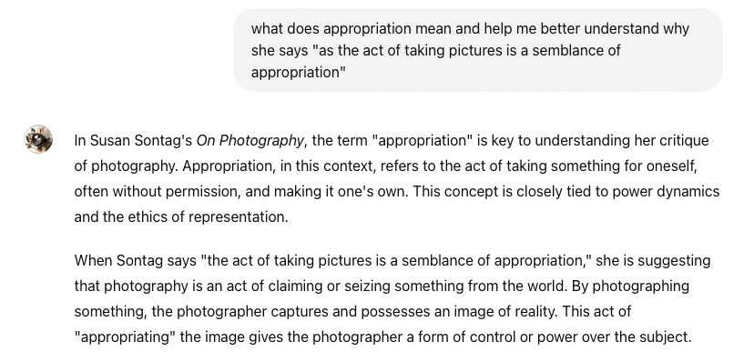
Create new avenues of accessing difficult texts
Asking ‘dumb’ questions

Slide 54
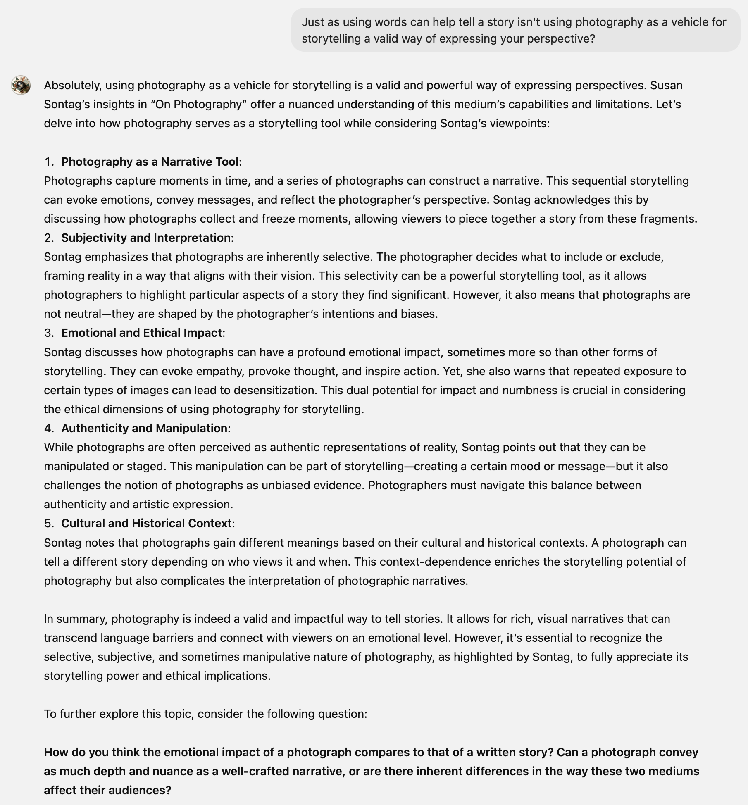
Create new avenues of accessing difficult texts
Arguing to better understand

Slide 55
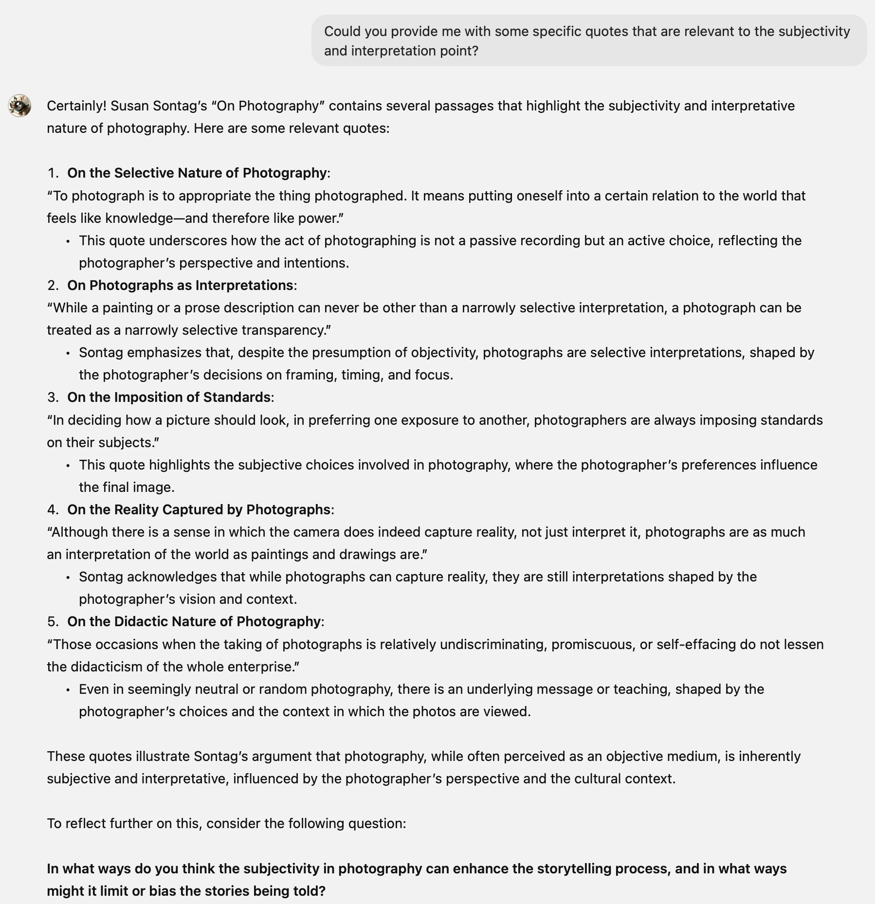
Create new avenues of accessing difficult texts
Finding the perfect quotes

Slide 56
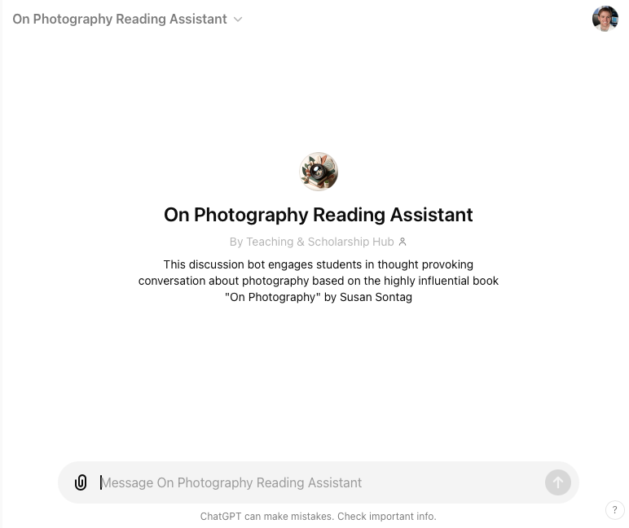
Create new avenues of accessing difficult texts
On Photography Reading

Slide 57
Use Cases
Melanie Hoag - Creating an AI Assistant
Andrew Bell - Four Use Cases in a First Year Seminar
Justin Ballenger - A Role for GenAI in Data Science Courses
Saif Mehkari - A Strategy for Deploying GenAI Tools Campus-wide

Slide 58
Low Code/No Code Tools for Data Analysis
Presented by H. Justin Ballenger, PhD
Morehouse College
August 15, 2024

Slide 59
Introduction
Low-code/no-code tools are gaining popularity due to their user-friendly interfaces and accessibility.
These tools enable individuals with limited coding experience to analyze and visualize data effectively.
In educational settings, they offer opportunities for enhanced research, data-driven instruction, and student projects.

Slide 60
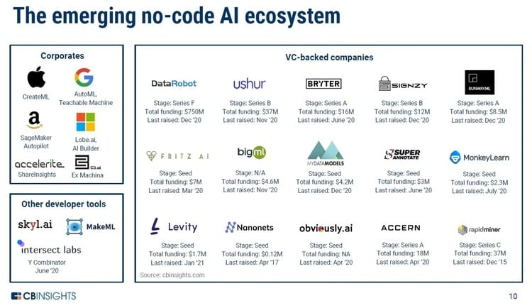

Slide 61
Benefits of Low-Code/No Code Tools
Assist students with editing and revising their work
Assist students with identifying key concepts and identifying holes in their work
Students can engage in deeper learning and identifying “holes” in their work
Helping students acquire micro-credentials that are useful in industry

Slide 62
Use Case: Analyzing AP Course Access with Civil Rights Data (Google Data Studio)
Learning Objectives:
Utilize generative AI tools to identify data sources and develop a plan for developing research questions and methods of analysis
Utilize Google Data Studio to connect with, clean, and visualize real-world educational equity data.
Gain insights into the distribution of access to Advanced Placement (AP) courses within a state.
Identify potential disparities in access to AP courses based on student demographics.
Practice data-driven storytelling to communicate findings effectively.

Slide 63
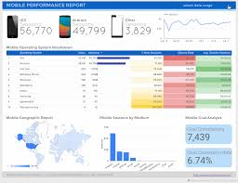
Use Case: Analyzing AP Course Access with Civil Rights Data (Google Data Studio) (Cont’d)
Connection to AI:
Data cleaning and preparation often involve AI-powered tools.
Data exploration and visualization can be enhanced by AI-driven insights.

Slide 64
Interaction with Low-Code/No Code Tools
Students gain practical skills in data analysis and visualization.
Faculty can foster data literacy and critical thinking.
The project promotes equity-focused inquiry and potential for social impact.
Skill development and increased engagement with data analysis.

Slide 65
Faculty Resources
Tutorials & Courses
Google Data Analytics Certificates - These certificates hosted on Coursera, can help people learn about R programming, SQL, Python, Tableau and more while gaining industry standard microcredentials.
"No-Code Data Analysis with KNIME" - This free, interactive tutorial provides a hands-on introduction to KNIME, a popular open-source platform for data analysis and visualization without coding.
"Introduction to Microsoft Power BI" - This Microsoft-led course provides an overview of Power BI's capabilities for data visualization and reporting, suitable for those with basic data literacy.

Slide 66
Recap
These tools enable faculty and students to:
Unlock data-driven insights without extensive coding knowledge
Enhance research, teaching, and learning experiences
Foster a culture of data literacy and informed decision-making

Slide 67
Contact Information
H. Justin Ballenger, Ph.D.
Assistant Professor of STEM Education
Co-PI NSF-iAAMCS
Research Lead, NSF-National Data Science Alliance
Division of Professional and Continuing Studies
Affiliated Faculty, Morehouse Center for Excellence in Education
MOREHOUSE COLLEGE | www.morehouse.edu
830 Westview Drive, S.W. | Atlanta, GA 30314-3773
horace.ballenger@morehouse.edu

Slide 68
Use Cases
Melanie Hoag - Creating an AI Assistant
Andrew Bell - Four Use Cases in a First Year Seminar
Justin Ballenger - A Role for GenAI in Data Science Courses
Saif Mehkari - A Strategy for Deploying GenAI Tools Campus-wide

Slide 69
ChatGPT Plus Clone
A tool for democratizing GenAI in Teaching & Learning

Slide 70
Quick History
Andrew created a Faculty Learning Community at UR to explore AI use in teaching & learning
We quickly realized two big structural issues:
Expensive ($20+ per platform per user per month)
Hard to talk across platforms

Slide 71
Cost Prohibitive
How expensive?
A single class at UR has roughly 16 students
Over one semester of using just ChatGPT Plus: $20 x 17 x 4 = $1360
For all of campus, this cost would balloon to roughly $350K per semester
With added data privacy, the cost would be roughly $425K per semester

Slide 72
Our Solution
Use the OpenAI API to create clone
The API charges by usage (vs. a flat rate), this results in significantly lower cost
API also provides better security and data privacy
So same as basic ChatGPT Plus, just with our own designed frontend

Slide 73
ChatGPT Plus Clone Usage
Approx. Usage Stats (for FLC):
2000+ requests
0.5 million+ words generated
100+ minutes transcribed
700+ images created
Total cost < $100
Used beyond FLC participants (60+ accounts)
We also provided temporary access to students in a few classes

Slide 74
Live Tool Demo

Slide 75
Benefits & Costs
Benefits:
Significantly cheaper
Can provide tools missing from ChatGPT (TTS and STT)
Can add tools from other vendors with the same interface
Better data privacy terms

Slide 76
Benefits & Costs
Costs:
In-House maintenance and support can be costly
Cannot provide all the features from ChatGPT Plus (as some are not available on API)
Some of the more advanced features such as those requiring RAG are quite expensive (so may not be cost effective on this tool)

Slide 77
What we are currently doing
The tool was put together hastily and added on to over the semester, so we are reengineering it from scratch
New features:
Under the hood technical improvements
Adding tools from Anthropic & Google
Better logging and chat history features
UR specific administrative tools

Slide 78
Take-away
Later this semester we hope to release a general version on github for anyone to use

Slide 79
Questions

