Slide 1


Introduction to
Authentic Assessments
KatieAnn Skogsberg
Centre College
ACS Workshop on Authentic Assessments
Notes:
Thank you for attending
Thank you to the ACS for supporting this project
Authentic assessments can mean a lot of different things.
Providing an overview of how we have conceptualized authentic assessments.
Start with a waterfall on “why are you here?”
DO NOT type anything until I finish the instructions
In the chat, type in just 1-3 words that explain why you are here.
I’ll give everyone about 15 seconds to enter your words, then when I say “GO” you’ll all hit return at the same time.
This is so that you are not influenced by someone else’s thoughts. I get your raw, first-thoughts.

Slide 2

Why are you here?
ACS Workshop on Authentic Assessments

Slide 3

Why are you here?
What are Authentic Assessments?
Practical Reasons
Make Assignments More Meaningful
ACS Workshop on Authentic Assessments
Notes:
How to design an authentic assessment.
How to use backward design.
How to align assessments with learning objectives.
Alternatives to exams.
Reduce motivation to cheat.
How to do it without increasing workload.
Told to do more authentic assessments
Improve student engagement
Promote deeper learning.
Make assessments real, so students understand why they need to know the material.

Slide 4

Why am I here?
My students were forgetting what they had learned
ACS Workshop on Authentic Assessments
Notes:
Even before the pandemic I was frustrated…
Students weren’t retaining what they learned
Didn’t we talk about this in 295?
Or even from the beginning to the end of the seemster

Slide 5
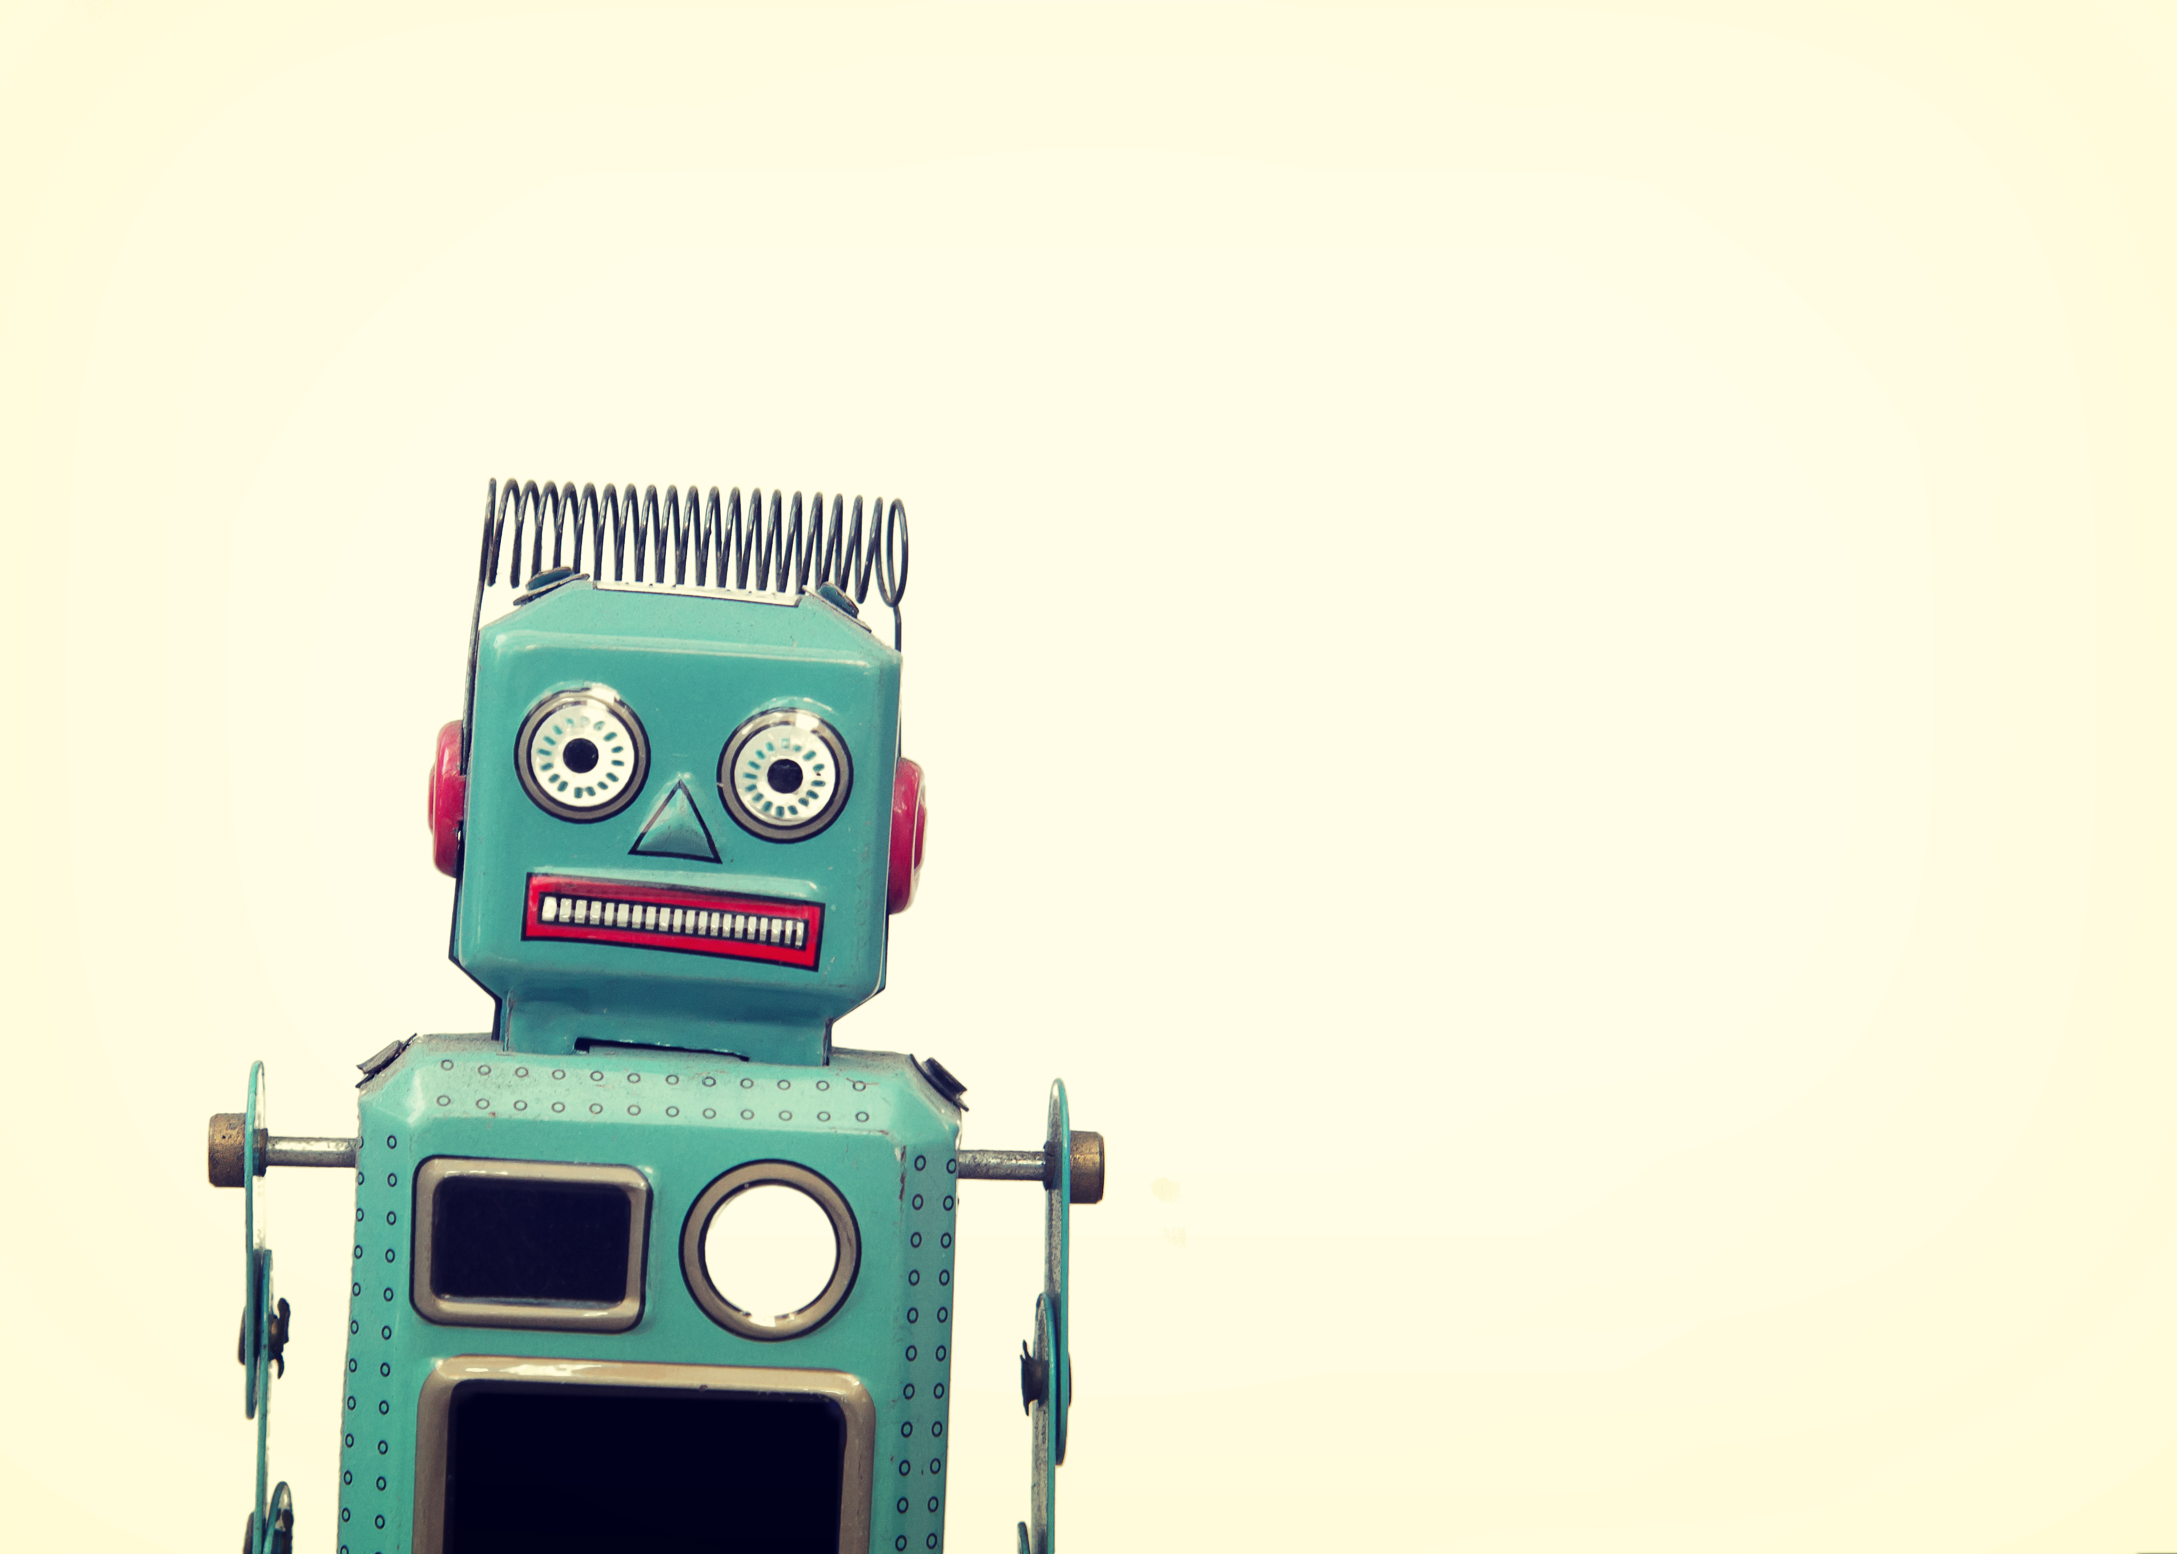
Why am I here?
They struggled when asked to transfer learning from one context to the next
ACS Workshop on Authentic Assessments
Notes:
Students couldn’t transfer knowledge from one context to another
When asking for examples of classical conditioning they’d parrot back the exact example I used in class.
If I gave them a new context, they got confused or used a thinly veiled replication of what I said in class.
They memorized the information, but didn’t know how to use or apply it.
Surely you can come up with your own example?

Slide 6

Why am I here?
My exams assessed their ability to study and take exams, but not what I truly valued.
ACS Workshop on Authentic Assessments
Notes:
Not assessing them on what I valued
My exams were testing the wrong things
Notoriously hard, Check all that apply.
Produced a nice normal distribution of grades
But my FAVORITE students were getting Cs
Students’ that ask the weird questions like “If you reanimated a brain, would it have the same memories? Would it be the same person?”
The curious ones struggled and 2nd guessed themselves
Testing working memory & testing skills
Some students had advantages others did not.
I’ve seen this answer before

Slide 7

Why am I here?
Pandemic
ACS Workshop on Authentic Assessments
Notes:
Exams were no longer valid, because everything was online
We were also worried about losing connections with our students
Like many of you, I started attending every online teaching workshop I could find to try to figure out how to each in this new environment
Somewhere I stumbled on the idea of doing authentic assessments.

Slide 8

Notes:
Somewhere stumbled on the idea of having students do authentic assessments
Let’s do another Chat Waterfall
Do not type in anything yet, and do not hit return, yet.
Take a moment to come up with 1-3 words that indicate what authentic assessments mean to you.

Slide 9
What are Authentic Assessments?
ACS Workshop on Authentic Assessments
Notes:
What does the phrase Authentic Assessment mean to you?
Chat Cascade

Slide 10
What are Authentic Assessments?
Applied
According to Muller (2005), Authentic assessments are "A form of assessment in which students are asked to perform real-world tasks that demonstrate meaningful application of essential knowledge and skills."
Or as Wiggins (1993) states “engaging and worthy problems or questions of importance, in which students must use knowledge to fashion performances effectively and creatively. The tasks are either replica of or analogous to the kinds of problems faced by adult citizens and consumers or professionals in the field.”
Meaningful
Creative
Personalized
Anything you want them to be
ACS Workshop on Authentic Assessments
Notes:
The paper from Muller that we sent out really defines AA
Anything you want them to be
How I conceptualize them
Applied: They actually do something that replicates something they’d do in their careers or to deal with a real-world problem.
Create a product for a client, write a small business grant application, explain how a piece of equipment works to a customer, create a storybook for your kids, anylize written material so that you can present a synopsis to your supervisor, write a research proposal.
Create: Can be “creative” but also in the generative sense. Multiple ways of doing the thing.
Personalized: The student has a way to make the assignment their own, or be able to contribute something that only they can. Students can connect with the material.
Meaningful: Needs to be able something that the student finds personally meaningful, that they can connect to either their personal interests or a real-world problem.

Slide 11


What I wanted to fix
Transferable
Applied
Content + Curiosity
Meaningful
Creative
Make it Personal
Personalized
Memorable
ACS Workshop on Authentic Assessments
Notes:
Revisit where I was coming from:
Students were forgetting, so making it meaningful, personal, and applied might make it more memorable
Having them apply the material to things that were personally relevant or solving real-world problems, would give them practice transferring their knowledge to a new context.
Allowing students to be creative might give the students with the weird questions a place to explore those ideas. It might also improve equity because it would allow students to bring in their own unique contributions. Especially for those who aren’t yet experts at “doing school.” It gives them a way to shine in other ways.
Making it personalized might help cut down on cheating and as with creativity, improve equity.
Making it meaningful should (according to cognitive scientists) improve memory retention.

Slide 12
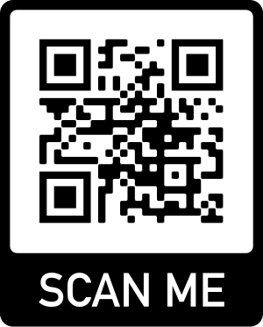
Artifacts as evidence of learning
Instead of exams
Artistic or Creative:
Drawings, Paintings, Photos
Practical and Applied:
Research proposals
Videos, Podcasts
Poems, Short stories
Analysis papers
Literature reviews
Written, PPTs, Videos
Infographics, Cartoons
ACS Workshop on Authentic Assessments
Notes:
Link to my instructions: Skogsberg_Overview of Authentic Assessments
OR: https://tinyurl.com/yphcf2u7

Slide 13

How do you grade them?
Rubric of required elements
ACS Workshop on Authentic Assessments
Notes:
Link to my rubric here: Skogsberg_Overview of Authentic Assessments
Or: https://tinyurl.com/4fkuzwv8
Key elements;
Correct number of terms
Terms/concepts correctly applied/explained
Glossary

Slide 14

Start with backward design
Align Assignments with learning objectives
Notes:
Link to my rubric here: Skogsberg_Overview of Authentic Assessments
Or: https://tinyurl.com/4fkuzwv8
Key elements;
Correct number of terms
Terms/concepts correctly applied/explained
Glossary

Slide 15
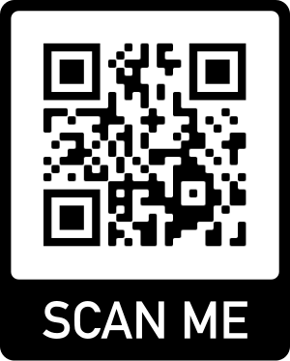
Rubric
Category | Requirement | Learning Objective
Content Accuracy | 10 terms applied correctly | Content
Research Beyond the Textbook | One valid external source | Content + Skills
Applying Material to a New Context (Creativity) | Application not found in textbook | Content + Skills + Transfer
Connection | Personal or Real-World | Content + Skills + Transfer
Communication | Accessible to a non-expert audience | Content + Skills + Transfer
Glossary | Correct definitions, accurately applied | Content
Mechanics | APA format, & clarity of writing | Content + Skills
ACS Workshop on Authentic Assessments
Notes:
Link to my rubric here: Skogsberg_Overview of Authentic Assessments
Or: https://tinyurl.com/4fkuzwv8

Slide 16
Examples of Student Work
ACS Workshop on Authentic Assessments

Slide 17
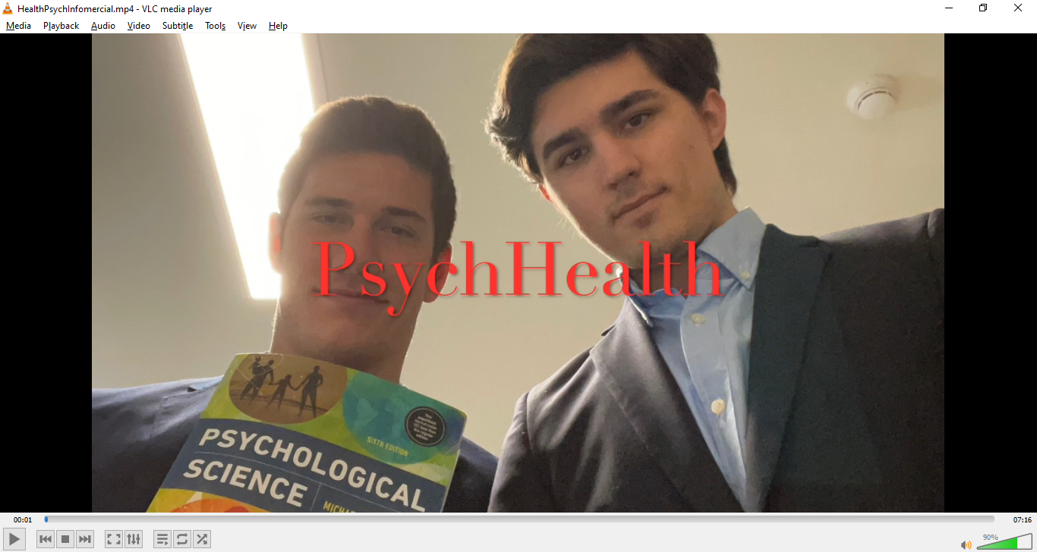
Examples of Student Work
ACS Workshop on Authentic Assessments

Slide 18


How did it go?
Transferable
Advantages:
Disadvantages
Content + Curiosity
Make it Personal
Confused
Too Much Work
Memorable
ACS Workshop on Authentic Assessments
Notes:
Some students still phoned it in and were able to get full credit
Re-dos were difficult to keep track of
Student Feedback:
Too much work
I asked for one for every chapter! It was too much work

Slide 19
What are Authentic Assessments?
Applied
Meaningful
Creative
Personalized
Anything you want them to be
ACS Workshop on Authentic Assessments
Notes:
The paper from Muller that we sent out really defines AA
Anything you want them to be
How I conceptualize them
Applied: They actually do something that replicates something they’d do in their careers or to deal with a real-world problem.
Create a product for a client, write a small business grant application, explain how a piece of equipment works to a customer, create a storybook for your kids, anylize written material so that you can present a synopsis to your supervisor, write a research proposal.
Create: Can be “creative” but also in the generative sense. Multiple ways of doing the thing.
Personalized: The student has a way to make the assignment their own, or be able to contribute something that only they can. Students can connect with the material.
Meaningful: Needs to be able something that the student finds personally meaningful, that they can connect to either their personal interests or a real-world problem.

Slide 21
Student Feedback
Student Responses to Course Evaluation Question “What skills did you develop while taking this course? “
  Student 3: I became a much better critical thinker after this course. We have to make artifact projects, where you had to apply what you learned to a new context. I had to be very creative when thinking about the best ways to make my artifact, especially since I chose to frequently make comics.
  Student 14: This class allowed me to apply my knowledge to more useful, real-life concepts through the use of the Artifacts.
  Student 16: I improved my speaking skills along with working creatively with the information that was taught. By combining the topics covered in class with good projects, I was able to put what i learned into real world scenarios
  Student 18: In this course we were challenged to analyze and make connections with the class material through Artifacts. This was a great alternative to taking tests as we had to not only know the information for that unit but be able to see the overlaps between units.
  Student 19: My ability to connect information across classes has greatly improved in this class. The things I’ve learned here I've been able to apply to things I learn in other classes in a more meaningful way than I ever have before.
ACS Workshop on Authentic Assessments

Slide 22
Points to ponder
Alignment with Learning Goals:
What learning goals or objectives does this assignment assess?
Do you need to revise your assignment to align with the objectives or vice versa?
Is the Purpose Clear?
Important for DEI (not everyone knows how to “do school.”
Do you ask students to identify what learning objectives it satisfies?
Do your students know what they must do to earn a passing grade?
Meaningful:
Will the students be able to answer the question “When will I ever use this?”
Are students able to personalize the assignment?
Does the assignment allow students to contribute through their unique abilities, perspectives, or interests?
Did you create your own learning goals and objectives, or did you inherit them?
Notes:
Are your assignments aligned with specific learning objectives from your syllabus?
Are there specific topics, concepts, or skills from your LOs that this assignment is designed to assess?
Did you employ Backward Design when creating the assignment?
Do the students know why they are doing the assignment?
Important for DEI reasons. Not everyone knows how to “do school.”
Are they made aware of the course objectives that the assignment satisfies?
Is the assignment meaningful or personally relevant to them?
Is it evident to them why or how they might use what they’re learning outside of your classroom?
Do the students know what they need to do to get a passing grade?
Do you provide a rubric or the “specifications” for what must be done?

Slide 23
Revisiting my learning objectives
Old Learning objectives
New Learning objectives
Big Questions:
WHY is psychology a science?
How good is your crap-detector?
Who are psychologists?
Learning Objectives: By the end of this course you will be expected to be able to…
Identify the major contributors, concepts, and applications of psychological research.
Describe the various research methods used in the psychological sciences.
Demonstrate the ability to make connections between the course material and "real world" contexts and applications.
Think critically about the assumptions, topics and examples presented in class.
Learning Goals (Higher-order ambitions):
To be able to use concepts from psychological science in the pursuit of your career goals, life goals, or to solve real-world problems.
Learning Objectives (Specific, measurable competencies).
Recognize important terms and concepts from specific topics within psychological science. (Content)
Apply your knowledge of basic research methods used in psychological science to evaluate and interpret hypothetical and real-world experiments and psychological phenomena. (Content + Skills)
Apply concepts from psychological science and experimental design to projects that are related to your specific career goals, life goals, or solving a real-world problem. (Content + Skills + Transfer of Learning)
ACS Workshop on Authentic Assessments
Notes:
Following the principles of backward Desgin

